Slide 1
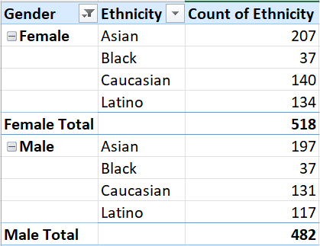
1)
Summary of the Gender & Ethnicity Distribution
Within the company
-from the above analysis we observe that most of the employees are Asians.

Slide 2
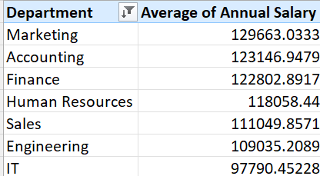
3)
Average Salaries blw different Departments
- There’s a slight difference of the average salaries blw different departments.

Slide 3
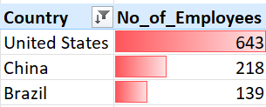
4)
No of Employees from Different Countries
-US tops the list

Slide 4
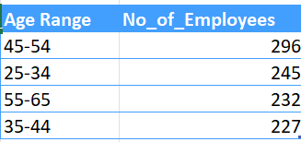
5)

Slide 5

6)

Slide 6
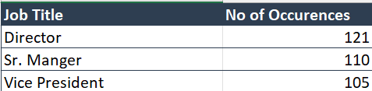
7)

Slide 7
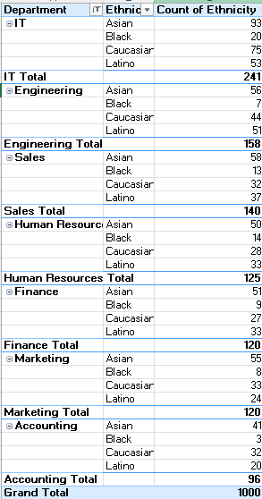
9)
Summary of the Ethnicity Distribution blw departments
Within the company

Slide 8
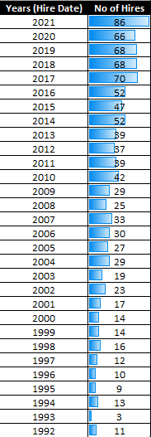
10)

